Slide 1
How to actually serve your ML models
Sharing what we‘ve been through and tips, takeaways
Pycon CZ 2023
Matěj Račinský

Slide 2
About me
Matěj Račinský
AI, Machine learning, MLOps, ML Engineering
Masters' degree from AI at FEE, CTU
Working at Avast, Gen Digital ~ 4 years
Using python ~7 years
https://github.com/racinmat
https://www.linkedin.com/in/matej-racinsky/

Slide 3
Agenda
Motivation, requirements
Julia story
Tensorflow,C++ story
Tensorflow Serving
Triton
TorchServe
Vertex AI
Huggingface Language models story
Notes:
Intro: 2 min
Julia: 5min
TF: 15min
Reqs and Naive 2min
Tf serving 4 min
Triton 4 min
Torch serve 5 min
Vertex AI

Slide 4
Slides
Notes and links if you‘re interested
Some more code samples in hidden slides
Presentation available online after the talk

Slide 5
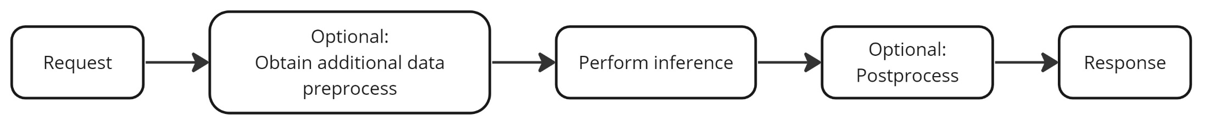
Motivation
Why to handle ML models differently than regular web app?
Mostly stateless
Larger artifacts
Compute-demanding
Versioning artifacts more often than code
Usual flow:

Slide 6
Requirements
Only wrapping model in REST API is sometimes not enough
Storing/versioning models
Monitoring, healthchecks
Update/rollback models, rolling update
Scaling (horizontal, vertical?)
...and much more
Notes:
Downloading additional data
Logging (requests, responses etc.)
Batching requests?
Option for custom python code? Custom libraries?
Usually you don‘t need everything, but the more, the merrier

Slide 7
Julia - 2020
Looks like Python, feels like Lisp, runs like C/Fortran
Already lots of code in julia
Need to quickly deliver
Everything custom
update of new model versions from mlflow
Multi-threaded server and healthchecks
Tuning the probes for k8s because of long startup times
Private packages, self-hosted package registry
...and much more
Notes:
Long startup times-need to precompile lots of code – cca 20 min building image, 5-10 min startup in a pod?
Problem with mem leaks, need to call the malloc_trim C function
Not able to bake precompiled code to docker layers
Needed to compile julia wiuth different GC
Other teams refusing to maintain it or even touch it
On-prem artifactory not supporting julia
CI/CD mostly disconnected from public internet
Figuring out proxying through corporate firewall
Writing lots of Kotlin DSL for TeamCity
logging to statsd
See talk https://www.youtube.com/watch?v=U5zt6OZVxrs&ab_channel=PyData for more details

Slide 8
Julia
Conclusion
Don‘t do it unless you have enough competent people
Has improved since then
Still lots of headaches and immaturities, lack of integrations
Gladly share mote details, just ask me
Notes:
Just stop me any time during the conference, I‘ll gladly discuss it

Slide 9
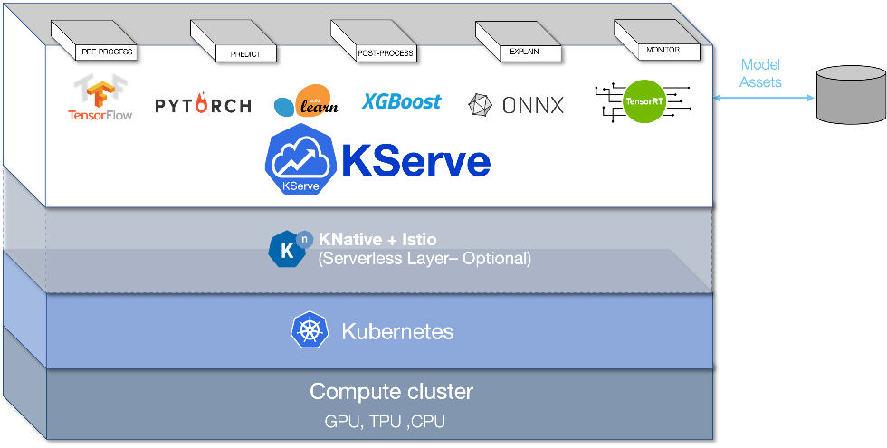
KServe
https://github.com/kserve/kserve
Standardized ML Inference platform on Kubernetes
Specification for the API Endpoints and request, response format
Formerly KFServing
Notes:
All the supported frameworks follow the same API
Support of several ML Frameworks, unified interface

Slide 10
Python+Tensorflow
Our needs&usecase
Julia -> Python & C++ & Tensorflow
On-prem -> GCP
Lots of json parsing -> C++ custom functions called from python
compiled C++ functions with python wrappers, not TF functions -> need to run TF in python for inference
custom keras objects
Reading features from GCS
Private package with custom keras objects: wanna-model
Returning logits, probabilities and classes at the same time

Slide 11
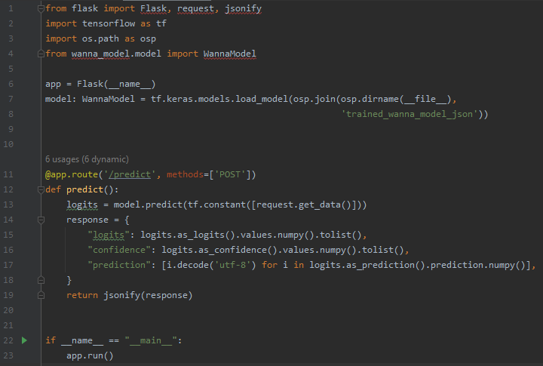
Naive solution
Pros | Cons
Speed, versatility | Everything else
Everyone knows it
Simple to debug

Slide 12
TensorFlow Serving
Pros | Cons
High-performance C++ server | Supports only traced models
Just works for standard TF models | Any custom code must be C++
Provides the KServe API | Model output must be simple tensor
SavedModel is confusing, Keras supports custom objects, TF does not
Notes:
No way how to use custom python code
No support of Keras custom objects

Slide 13
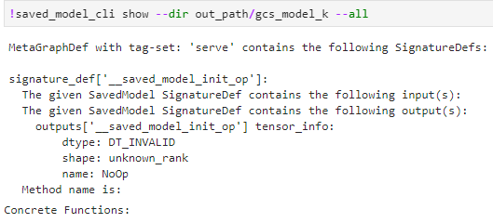
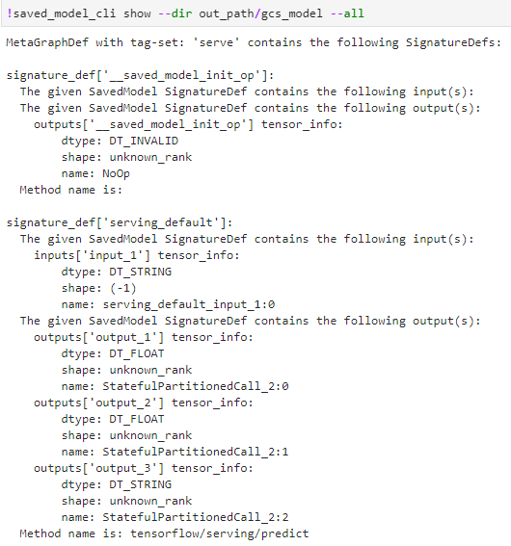
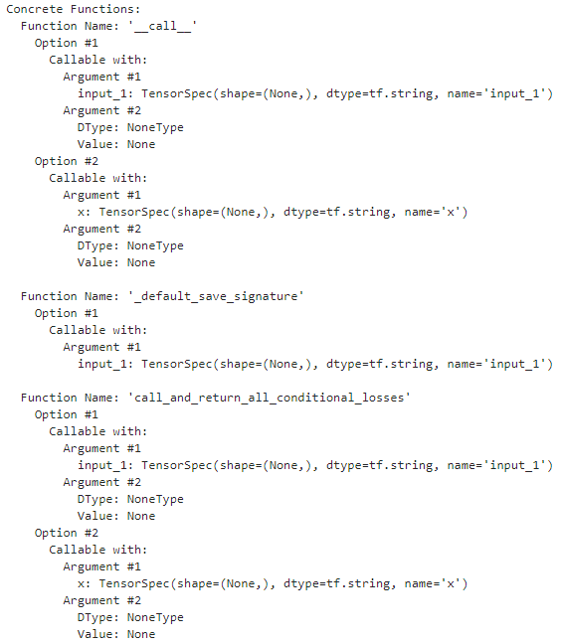
TensorFlow Serving
https://www.tensorflow.org/guide/saved_model
Ways to examine model:

Slide 14
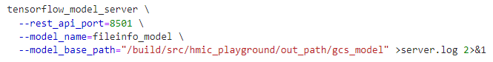
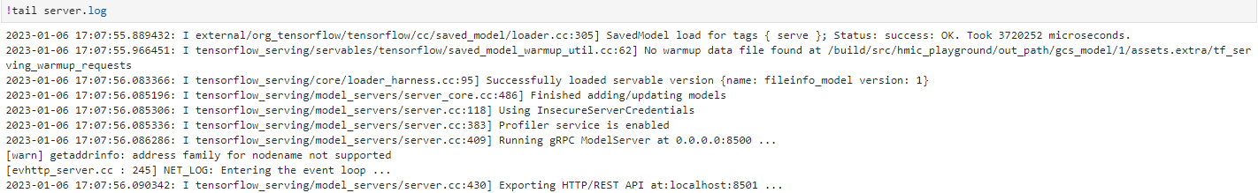
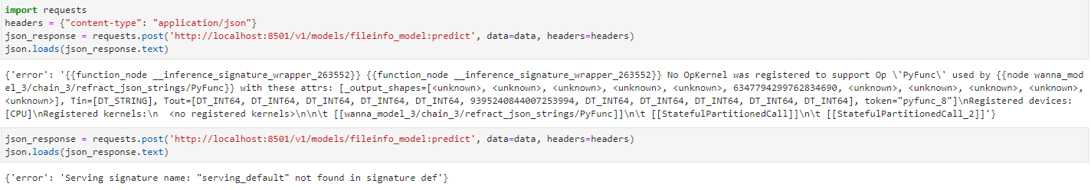
TensorFlow Serving
Running the model:

Slide 15
Triton
Pros | Cons
High-performance C++ server | Installation: Compile or docker image
Support for many backends | Compile C++ for specific py versions
Support for custom python code | Large docker images
https://towardsdatascience.com/hugging-face-transformer-inference-under-1-millisecond-latency-e1be0057a51c
Serving of transformer 4.1x faster than FastAPI
Notes:
Inference server by Nvidia
Supports: TensorRT, ONNX, TF, PyTorch, OpenVINO, Python, DALI, FIL
If you have different pyhton version than is bundled, you need to compile

Slide 16
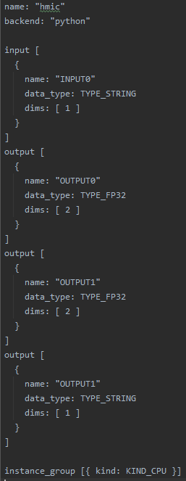
Triton
Usage: prepared docker image or compiled C++ server
Input and output types:
Automatic: for TF traced model, TensorRT, ONNX, OpenVino
For custom python need to specify manually in config.pbtxt
Not many examples or tutorials in general, smaller adoption
Notes:
Usually it‘s enough to start server with path to the models
If you have different version than the docker images, you need to compile C++
Input and output types:
Some special conventions for PyTorch
Lots of examples for the python backend
Contains also python client code

Slide 17
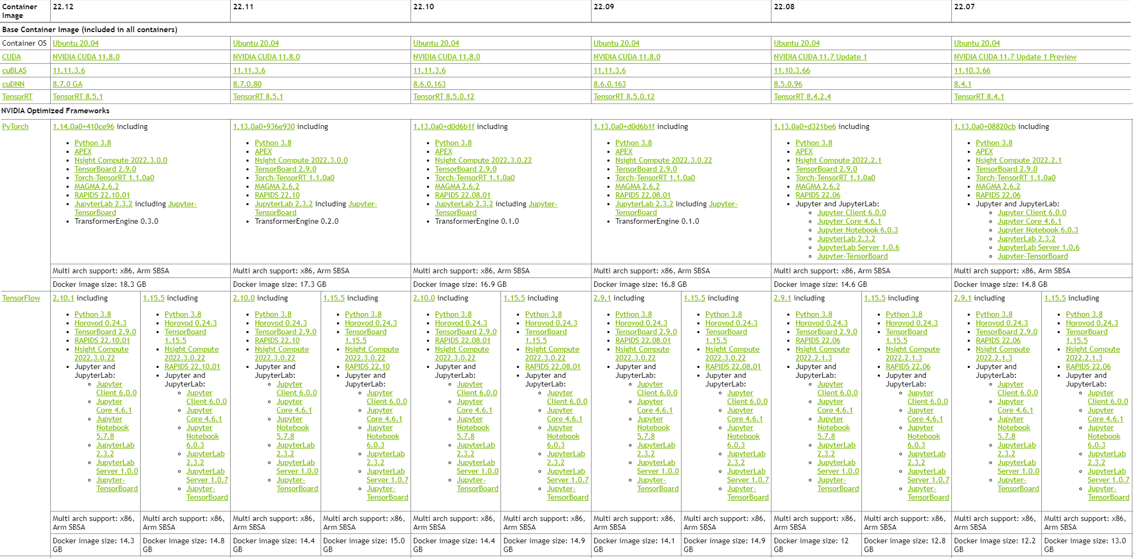
Triton - Available versions

Slide 18
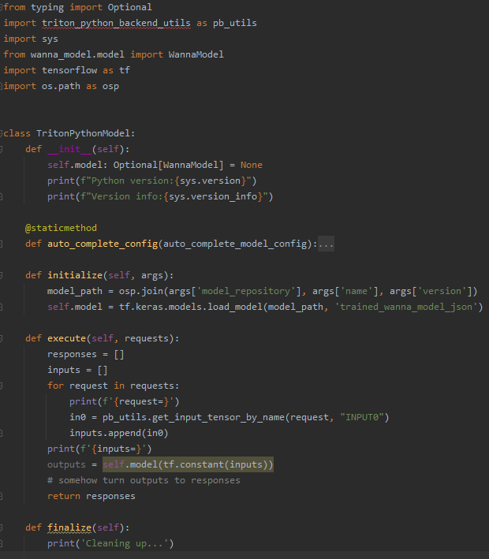
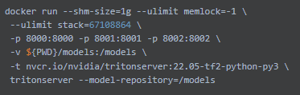
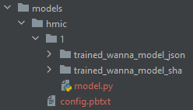
Triton – python backend

Slide 19
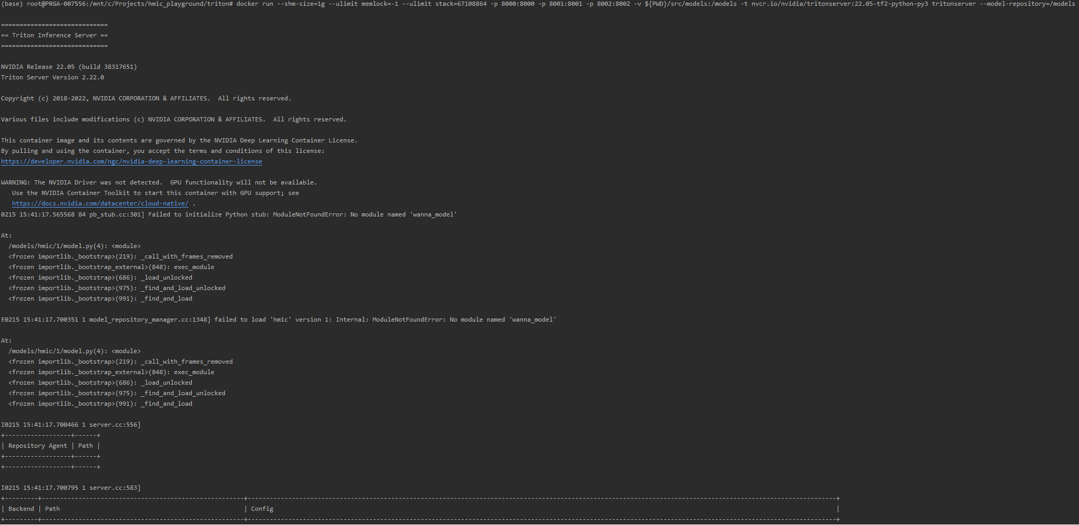
Triton – running into errors

Slide 20
TorchServe
Pros | Cons
High-performance Java Server | Non-intuitive req/response formats
Supports any python version
Support arbitrary python code
Installable via pip
Wrapping any model into mar file
Can be used without PyTorch

Slide 21
TorchServe
API for
Predictions
Monitoring
Model management (add new models, switch them etc.)
MAR allows to provide requirements.txt
Able to install from both private and public pip registry
Config file
Notes:
Supports minibatching if reqs are close to each other
Kserve already has multiple instances per request -> batching them leads to batch of batches, if need to process them at once, we want to flatten the batch of batches, but keep the information about structure so we can un-flatten them later
Can be used in two „regimes“
Single docker image, multiple models with different deps
Assumes pip registry is reachable during runtime
Specialized docker image, installed deps, faster startup, single model per server

Slide 22
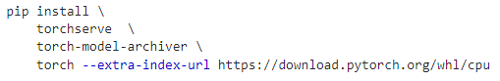
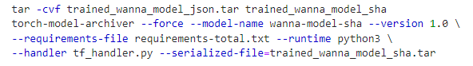
TorchServe
Install server, archiver, optionally pytorch
Write the custom handler
Prepare your mar
Start server
???
Profit
Notes:
Mar format and config in hidden slides

Slide 23
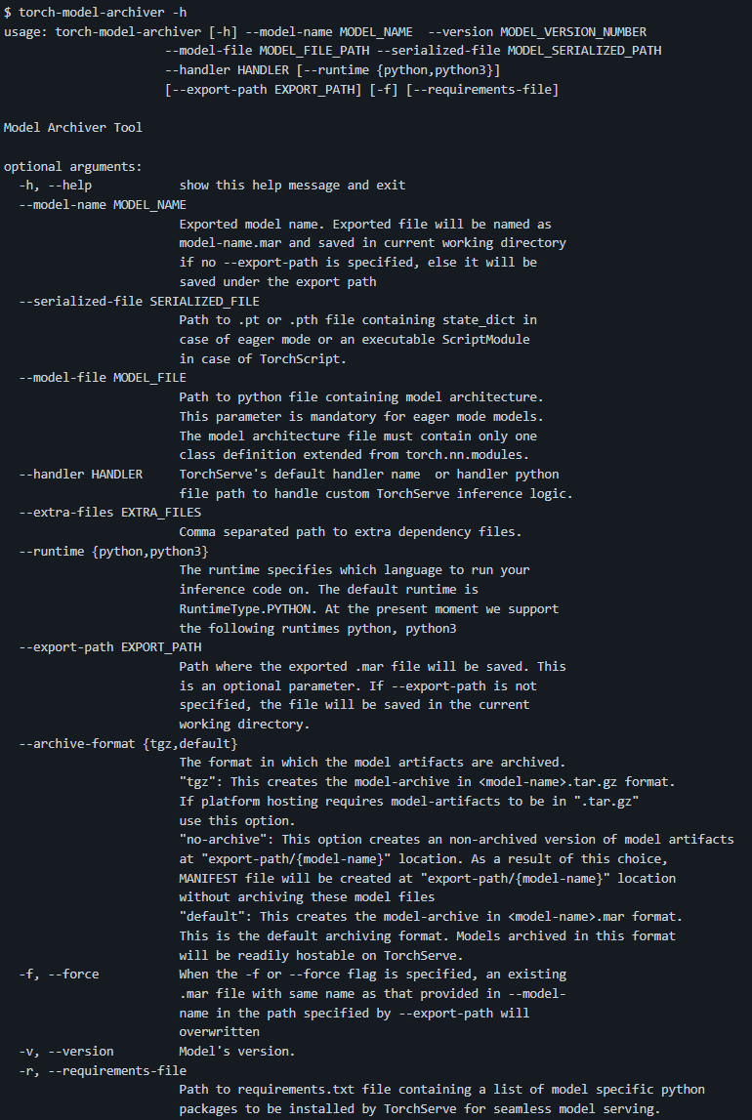
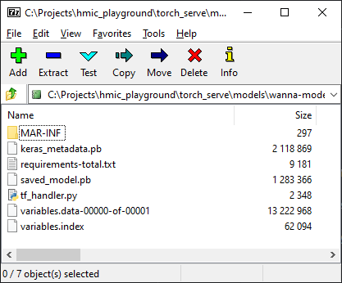
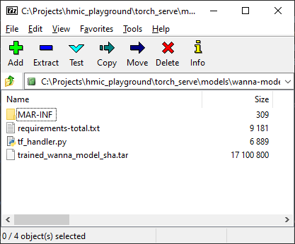
TorchServe – Model Archiver
--model-file not needed
--serialized-file can be anything, no validation
--extra-files are flattened, dir structure not retained
Archive (can open it in 7z)

Slide 24
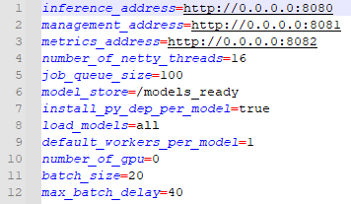
TorchServe – configuration
Docs here

Slide 25
TorchServe – model management
Load models when server starts
Add new models at runtime (must have different version) using API
Switch between versions at runtime using API

Slide 26
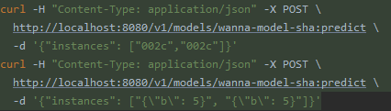
TorchServe – custom handler
2 prediction APIs
TorchServe
Single sample per req
KServe
More samples per req
Custom handlers need to support both (or let one of them crash)
Function recieves list of requests, returns list of responses
Notes:
The 2 apis are no problem for built-in handlers
Custom handlers, 2 apis: Everything goes to same function
Need to manually handle grouping and un-grouping
All tutorials show extending the default handler
Imports torch
You can duck-type custom handler without base class

Slide 27
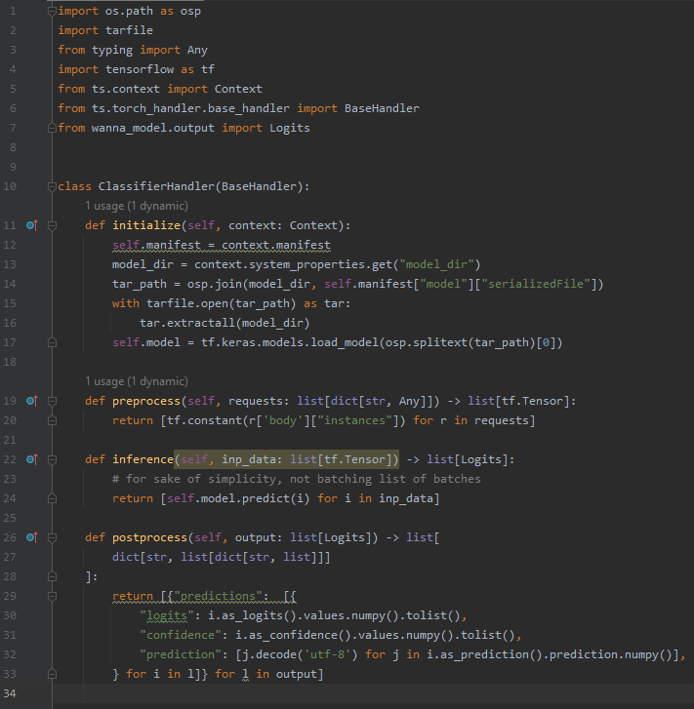
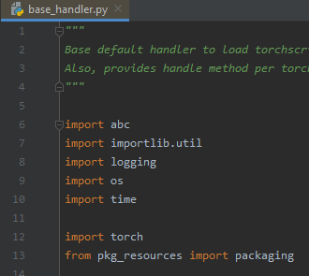
TorchServe - handler
Extending BaseHandler
Very easy to use
Needs pytorch installed

Slide 28
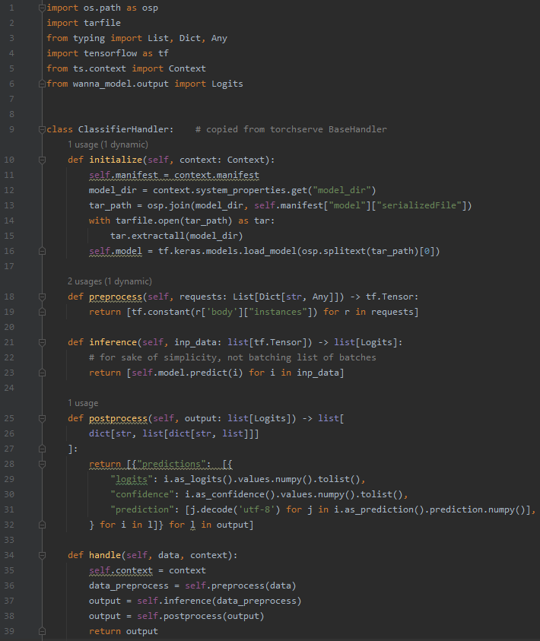
TorchServe - handler
Without base handler
Duck typing
Single file with single class
Needs handle method
Lots of copypasting for full feature set
Notes:
This is minimal example, not supporting explanation or all formats, this is just for the kserve one
I did not find anywhere you can do that

Slide 29

Inference in Vertex AI
The way™ for online predictions in GCP
Model registry
You put models here
Endpoints
You deploy models from registry to endpoint
Autoscaling (min. 1, for scaling to 0 you need cloud run)
Logging and metrics of resource usage, request&response, timing...
Adds model id, version and name to the response
Notes:
Model registry has immutable models – the docker image nad artifact get probably copied somewhere, stay the same after the rewrite of original locations
Docs
Use bash/cli tools or python to interact with Vertex AI
Links model artifact with specific docker image

Slide 30
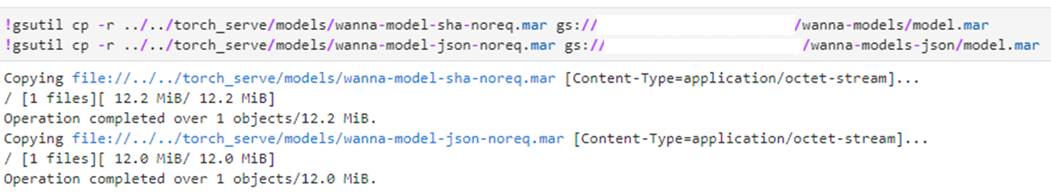
Vertex AI – model registration
Build the docker image and push it
Copy the mar files to GCS

Slide 31
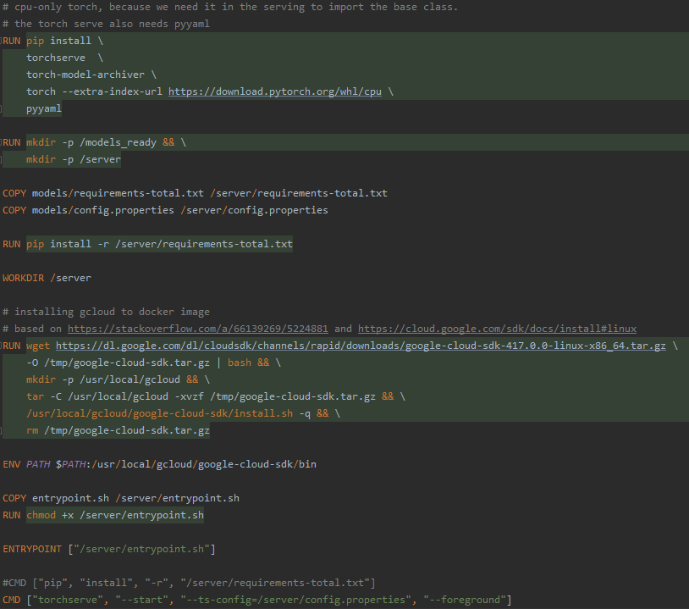
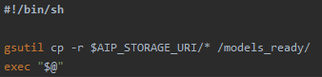
Docker image
Artifact uri-> AIP_STORAGE_URI

Slide 32
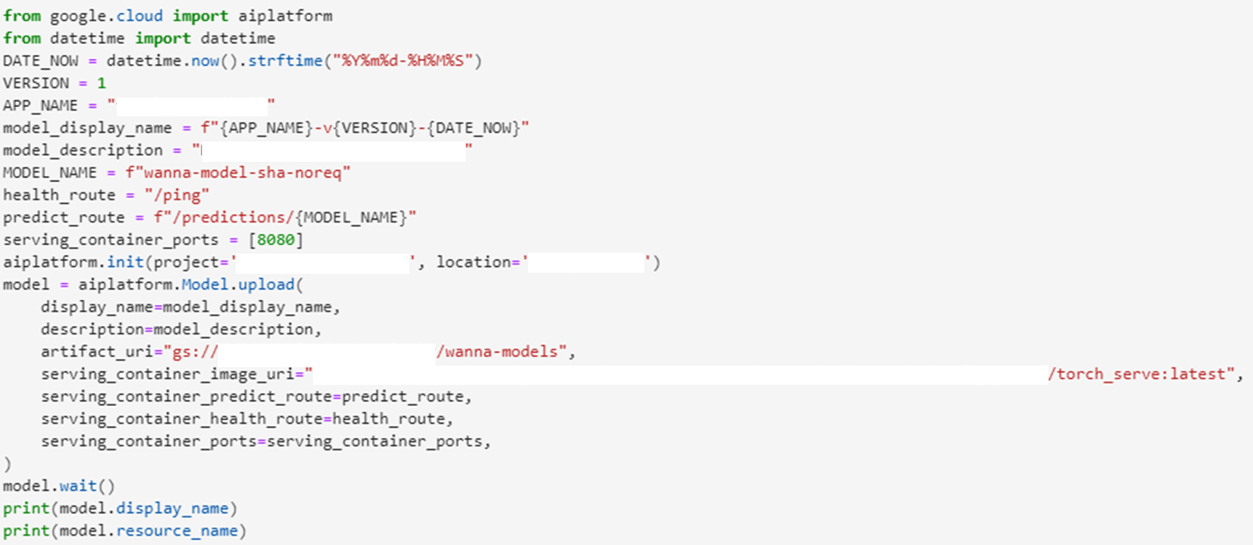
Vertex AI – model registration
Notes:
Todo: smazat názvy věcí

Slide 33
Vertex AI – model registration
After the registration, it seems both container and artifact get copied somewhere
Registering model, replacing both docker image and artifact under same name and then deploying it lead to deploying the old stuff, not newer ones

Slide 34
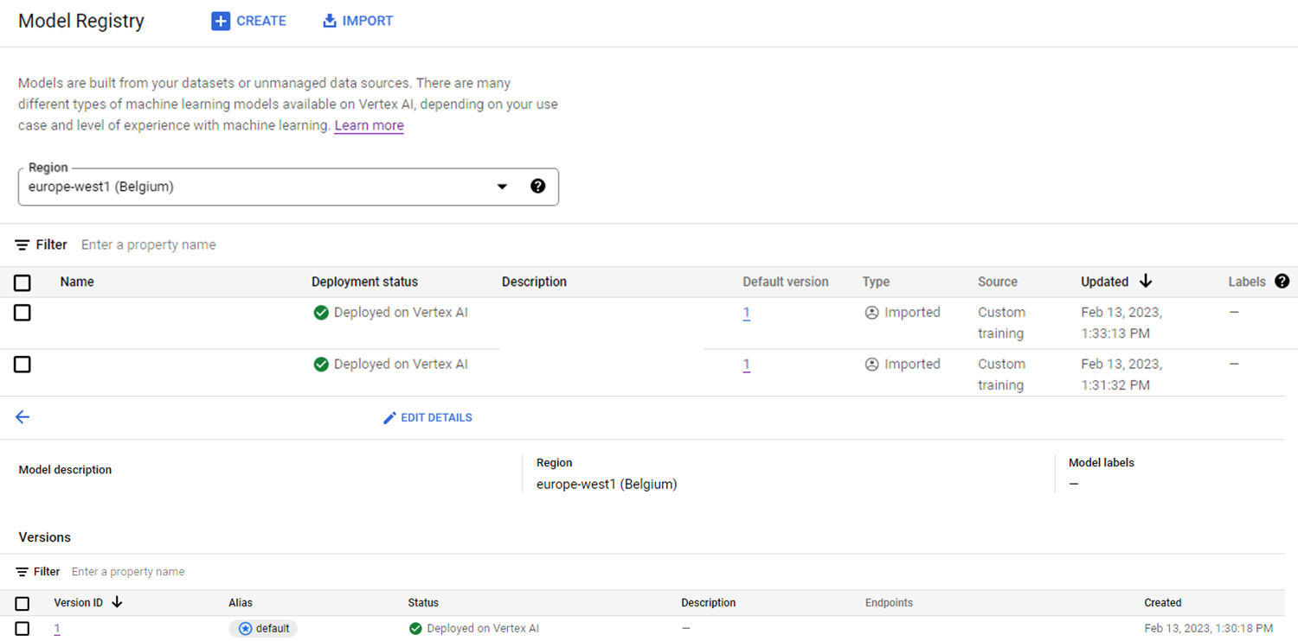
Vertex AI – model registration

Slide 35
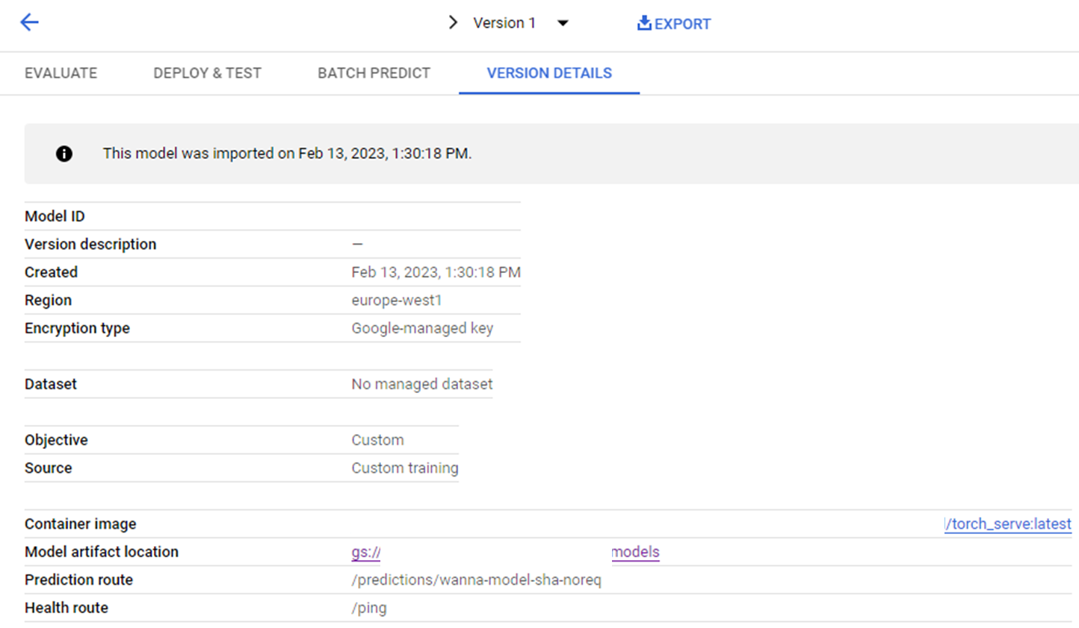
Vertex AI – model registration
Notes:
Todo: začernit service accounty a projekty

Slide 36
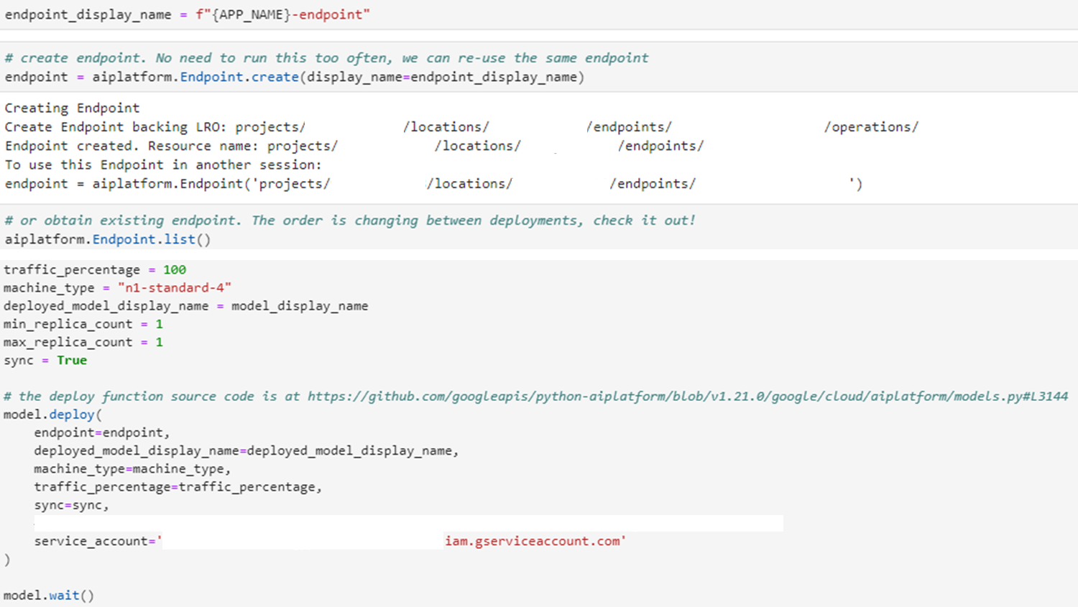
Vertex AI – deployment
Notes:
Todo: začernit service accounty a projekty

Slide 37
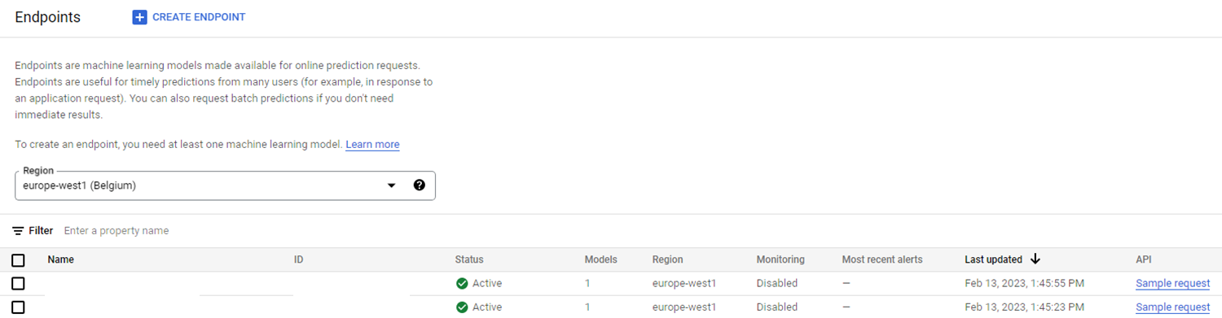
Vertex AI – deployment
Notes:
Todo: začernit service accounty a projekty

Slide 38
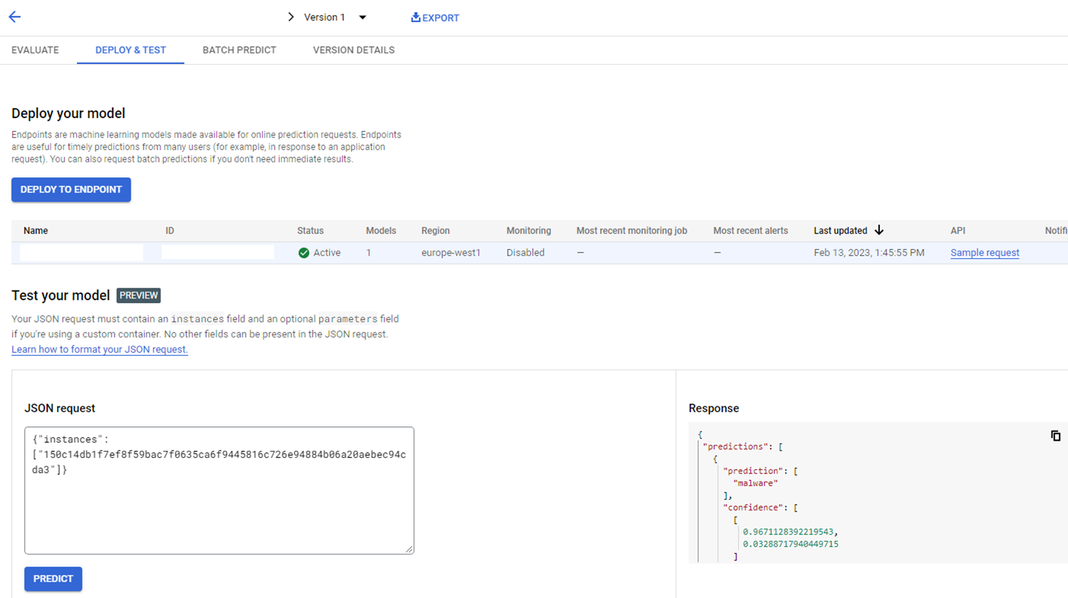
Vertex AI – model registration

Slide 39
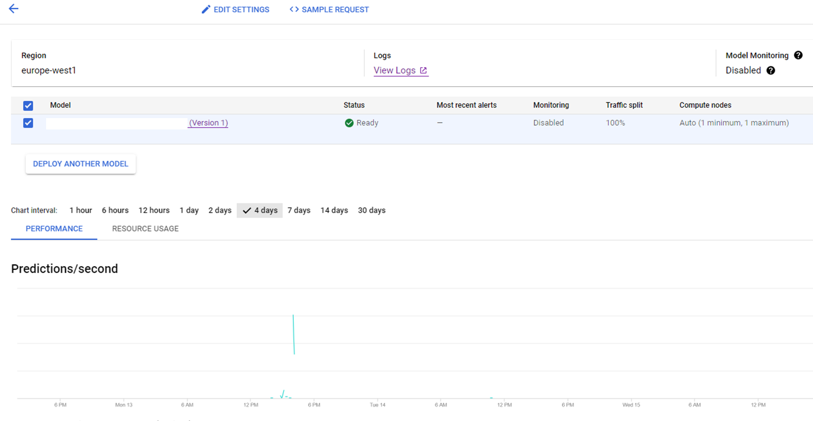

Slide 40
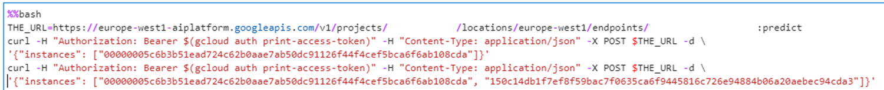
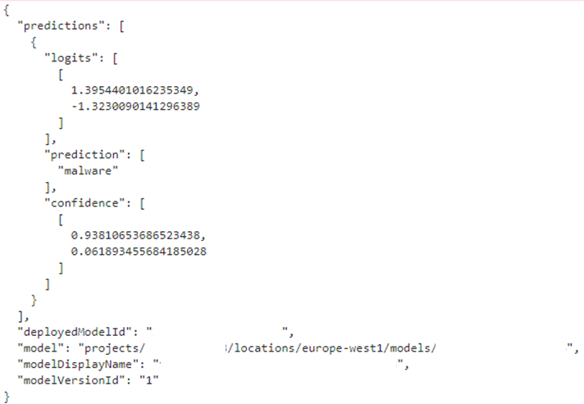
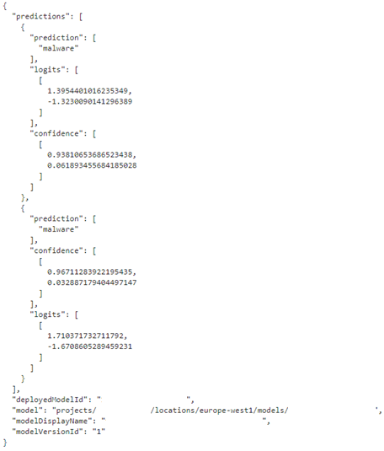
Notes:
Todo: začernit service accounty a projekty

Slide 41
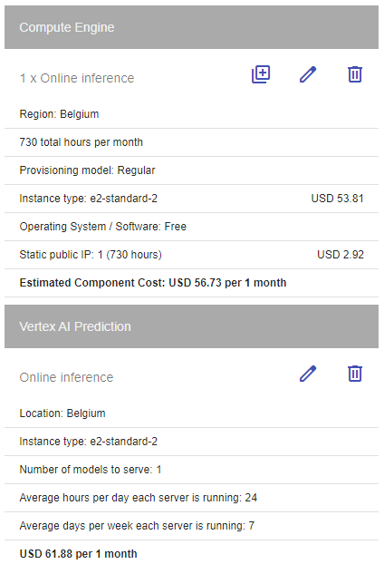
Vertex AI Endpoint
Scaling
up to specified # replicas, based on CPU utilization in %
Didn‘t try yet
Costlier than VM
Notes:
I thought specialized services are chaper than spinning a VM. I was wrong.
Vertex AI+torchserve-more workers per model?
Cheaper alternatives....cloud run? https://medium.com/google-cloud/how-to-reduce-your-ml-model-inference-costs-on-google-cloud-e3d5e043980f

Slide 42
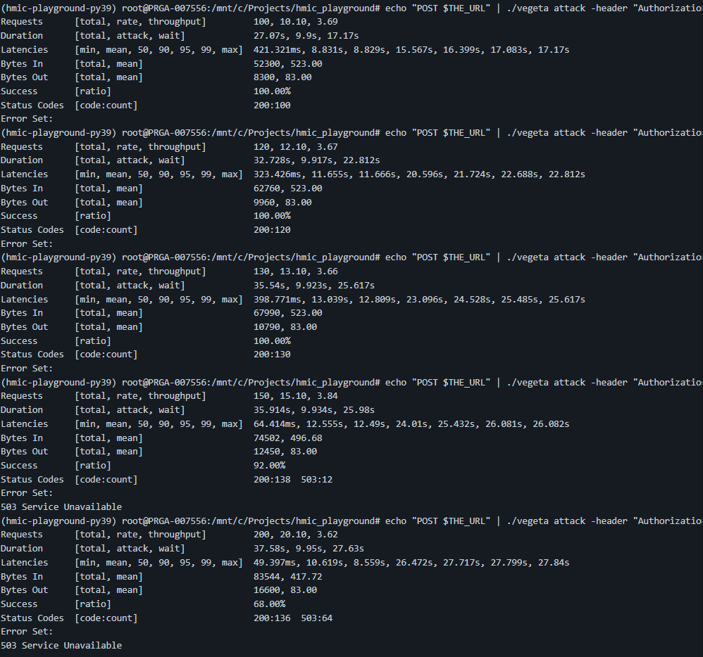

Stress test
My benchmarks,
using vegeta

Slide 43
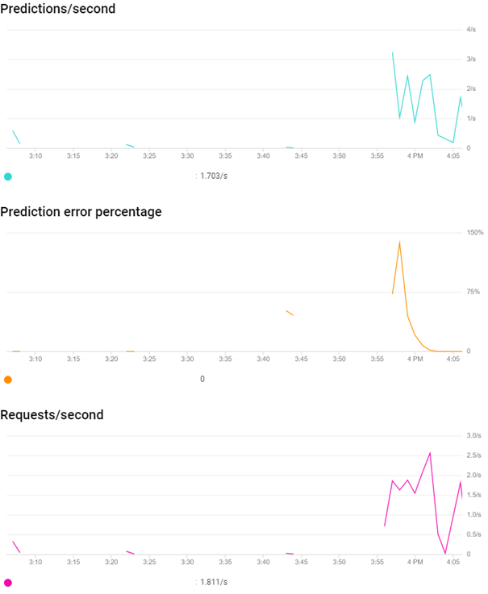
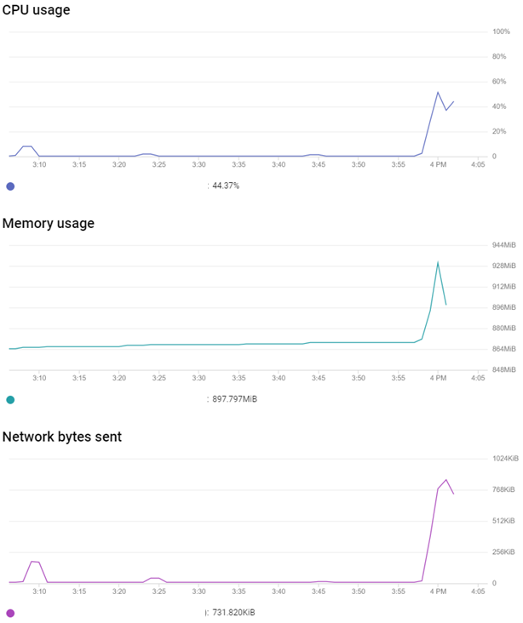
Stress test

Slide 44
Small language models
Huggingface models, custom preprocessing, optionally scikit learn model, ensemble of HF models
Quick iterations – starting with python API, so far staying there
~82M parameters, ~300MB on GPU

Slide 45
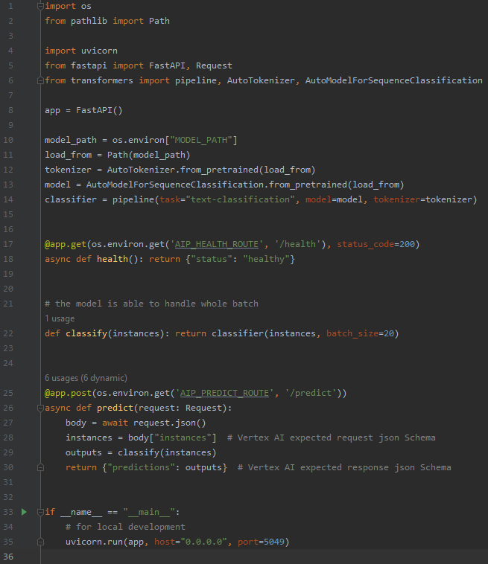
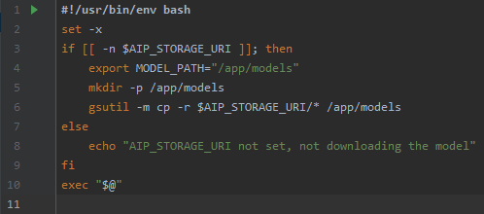
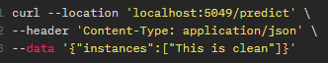
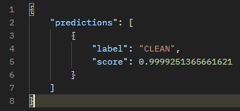
Transformers, fastapi

Slide 46
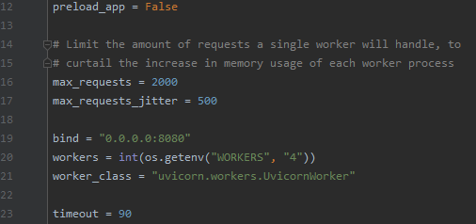
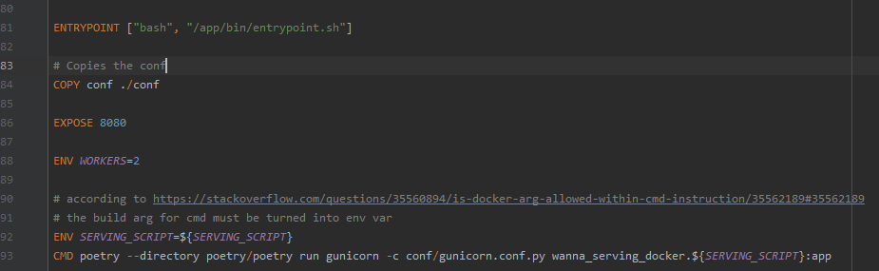
Running it in docker
Using gunicorn

Slide 47
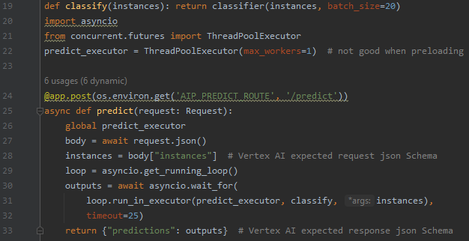
Fastapi – next steps
No async
No await
Serve using gunicorn
Great article
Multiple gunicorn workers in single server
Idea: share the ML model between workers
Vertex AI Endpoint /dev/shm (default 64MB)
does not allow to raise /dev/shm, open issue
Every worker with its own model
huge increase in memory req.
Whole server Async, model call blocking
Asyncio has debug mode
detects >100ms blocking calls
Separate working pool
Notes:
Shared model across workers: Sounds great, does not work
So each worker must have its own model -> consumed memory = const overhead
In case you use preloading of workers in gunicorn, executor loop needs to be instantiated in a function, not global state

Slide 48
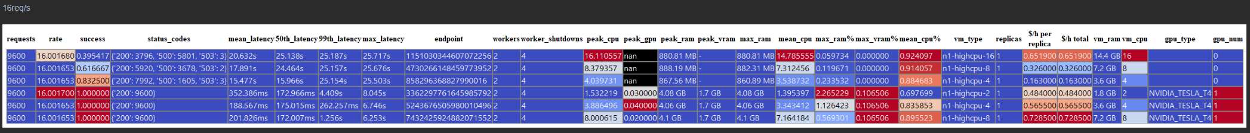
Stress test, vegeta, GPU vs CPU, tuning # cores
Notes:
Parsing vegeta output, pulling metrics and logs from gcp to obtain rest of the numbers

Slide 49

Metrics during the load test

Slide 50

GPU utilization, autoscaling

Slide 51

Memory usage over the max?
Over 4GB of ram for vm type with 3.6GiB maxRAM and 1.8GiB max RAM, only with GPU
Maybe summing RAM and VRAM?
Ticket to GCP support

Slide 52

Memory usage over the max?
The metric is ok, showing only RAM
Bug in the scheduler, schedules docker container to larger VM, does not show anywhere, prices for the smaller one
Free money glitch?

Slide 53

Debugging inside the deployed model
Reverse Shell
No way to ssh into deployed model
LocalModel and LocalEndpoint may not be enough
rawPredict does not perform validation

Slide 54

Reverse shell - python

Slide 55

Reverse shell - shell

Slide 56
Summary
Started with Julia on-prem -> Python, TensorFlow, C++, TorchServe in GCP
FastAPI is enough for many cases
Tied to GCP now
goodbye mlflow
Everything needs a docker image
Try the stuff outside of the docs, experiment

Slide 57
Next Challenges
CI/CD
deployment with traffic split
Sanity checks
Automated rollbacks
Serving LLMs
VLLM, HuggingFace Text Generation Inference

Slide 58


Thanks for your attention
Questions?

